Slide 1
IEEE IAS ENIS Website
Specification Document of the website

Slide 2
Table of content
Overview
Team
Goals
Phases
Content
Design
Functionality
Accessibility
Browser Support
Hosting
Ongoing support and Maintenance
Assumptions
Milestones
Deadlines
Budget
Template download

Slide 3
Overview & Goals
The point of the site, what it's gonna offer, what we need it to do and target market and bla bla....

Slide 4
Phases
Work progress:
Basic static marketing website: current site
Add simple backend for newsletter
Add maintenance and update backend for articles

Slide 5
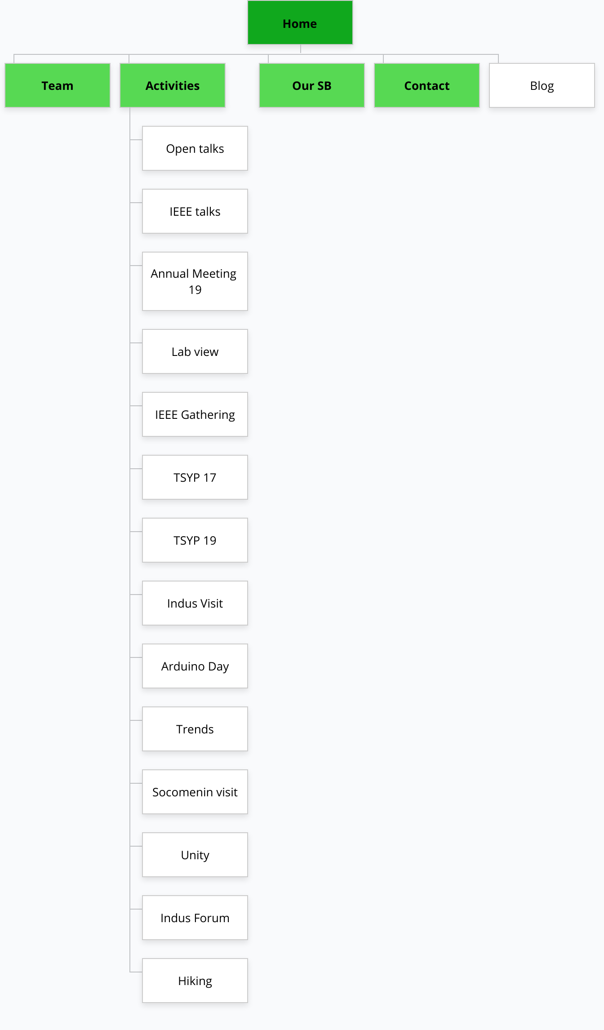
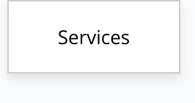
Content
Structure
Site map:
https://www.gloomaps.com/exhdpwjxXw

Slide 6
Design
Graphic Chart:
Colours
Typography
Hovers
Animations
Grid system
spacing

Slide 7
Functionalities
Current: simple static pages
Adding:
Log in space
Multilanguage capapilities
Performance enhancing
Other stuff...

Slide 8
Accessibility & Browser support
Talking about all the limitations and exceptions this site has:
From devices to certain browsers..

Slide 9
Hosting
Hoster info and requirements: prices and capacity and other shit...

Slide 10
Maintenance
Everything that should be maintained and updated regurarly,
outline any support and maintenace requirements that you have.

Slide 11
The Template:
Github: https://github.com/O7Mejri/IAS-ENIS.git
Other links: (drives or whatever...)

